Slide 1
Independent paths and cut sets

Slide 2
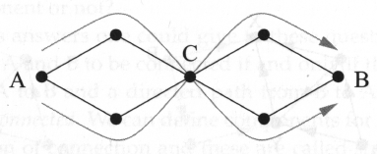
Independent paths
Edge-independent: two paths do not share the same edge
Vertex-independent (node-independent): two paths do not share the same vertex other than the starting and ending vertices.
Sometimes, independent paths are also called disjoint paths.

Slide 3
Connectivity
Edge connectivity between a pair of vertices: the number of edge-independent paths between these two vertices.
Vertex connectivity between a pair of vertices: the number of vertex-independent paths between these two vertices.

Slide 4
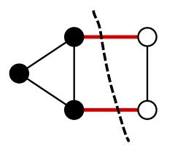
Cut set
(Vertex) cut set is a set of vertices whose removal will disconnect a specified pair of vertices.
Edge cut set is a set of edges whose removal will disconnect a specified pair of vertices.
Minimum cut set is the smallest cut set that will disconnect a specified pair of vertices.

Slide 5
Menger’s theorem
If there is no cut set of size less than n between a given pair of vertices, then there are at least n independent paths between the same vertices.
The theorem applies both to edges and to vertices.

Slide 6
Menger’s theorem
Menger’s theorem implies that the number of vertex-independent paths must be greater than or equal to the size of the minimum cut set.
On the other hand, if there are exactly n vertex-independent paths, then one has (at least) to remove a vertex from each path.
The size of the minimum cut set is not less than the number of vertex-independent paths.
The size of the minimum cut set is equal to the vertex connectivity.

Slide 7
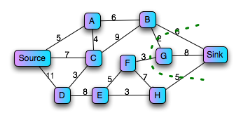
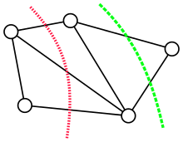
Max-flow/min-cut theorem
Sink
Source

Slide 8
Max-flow/min-cut theorem
The edge version of Menger’s theorem
Imagine a network of water pipes.
Each edge has a maximum flow rate r.
What is the maximum flow rate from vertex A to vertex B?
Suppose that there are exactly n edge-independent paths between A and B.
Each edge-independent path can carry a flow with rate r.
Thus, the maximum flow is at least nr.

Slide 9
Max-flow/min-cut theorem
Menger’s theorem implies that there is a cut set of n edges between A and B.
As each edge can carry at most flow r, removing the cut set reduce at most nr flow.
After the removal of the cut set, the network is disconnected and the flow is 0.
This then implies that the maximum flow cannot exceed nr.
The maximum flow is exactly nr, where n is the number of edge-independent paths (the minimum cut set).

Slide 10
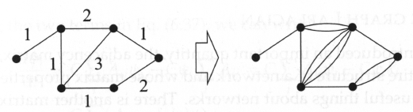
Max-flow/min cut theorem for weighted networks
In a weighted network, each edge is assigned a weight (link capacity).
The maximum flow between a given pair of vertices is equal to the sum of the weights on the edges of the minimum edge cut set that separates the same two vertices.
Start from the problem with integer weights.
Transform the weighted network into a multiedge (unweighted) network by replacing an edge with weight w by w edges.
General weights: allow r to 0 in the limiting case.

